Slide 1
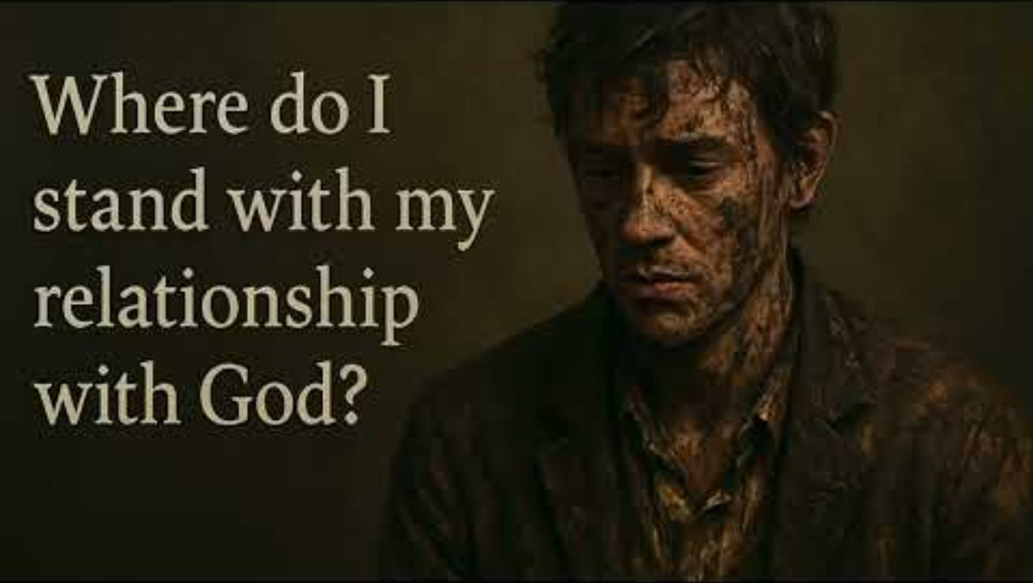

Slide 2

Life in the Spirit Seminar
Session 2 - The Love of the Father

Slide 3
Four Things to Remember
TRUST in God’s plan for your life
“The Lord has amazing plans for my life.” 1Cor 2:9
SURRENDER to His will for you
“The Lord is doing something new in my life.” Isa 43:19
BELIEVE in Jesus and His true presence in the Eucharist
“The Holy Spirit guides me to all truth.” John 16
RECEIVE all He has to gift freely to you
“The Lord is my shepherd and I lack nothing.” PS 23:1

Slide 4
Garments of Praise
Put on the garments of praise for the spirit of heaviness
Let the oil of gladness flow down from Your throne
Put on the garments of praise for the spirit of heaviness
Your joy is my strength alone my strength alone
Make these broken weary bones rise to dance again
Wet this dry and thirsty land with a river
Lord our eyes are fixed on You we are waiting
For Your garland of grace as we praise Your name

Slide 5
Put on the garments of praise for the spirit of heaviness
Let the oil of gladness flow down from Your throne
Put on the garments of praise for the spirit of heaviness
Your joy is my strength alone my strength alone
Make these broken weary bones rise to dance again
Wet this dry and thirsty land with a river
Lord our eyes are fixed on You we are waiting
For Your garland of grace as we praise Your name

Slide 6
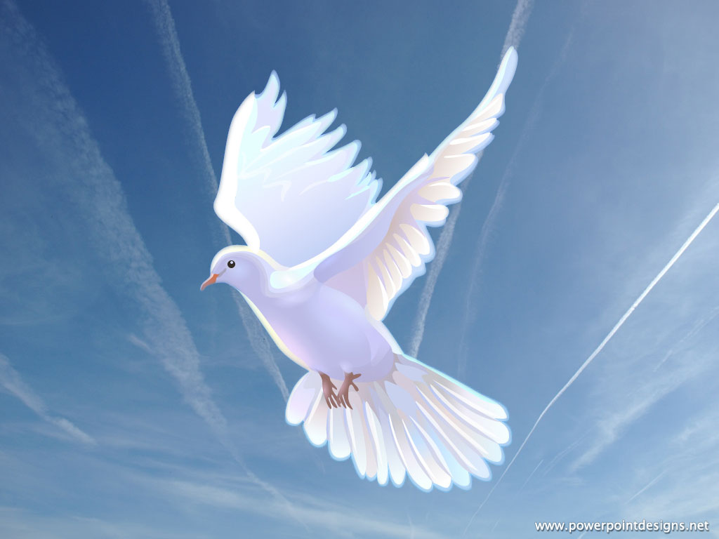
This Photo by Unknown Author is licensed under CC BY
"Come, Holy Spirit, fill the hearts of your faithful and kindle in them the fire of your love. V. Send forth your Spirit and they shall be created. R. And You shall renew the face of the earth. Let us pray. O God, who by the light of the Holy Spirit, did instruct the hearts of the faithful, grant that by the same Holy Spirit we may be truly wise and ever enjoy His consolations. Through Christ Our Lord. Amen."

Slide 7
Living in the Kingdom through Faith
The decision to live our Baptism Promises is the beginning; acting on that decision makes it effective.
Jesus said that the Kingdom of Heaven is God’s reign over our lives and hearts here on earth.
We cannot experience the full effect of our relationship with God unless we trust as little children.
Faith is more than merely believing in God, it requires Trust.
Many say that they trust God , when in fact they only believe in Him.

Slide 8
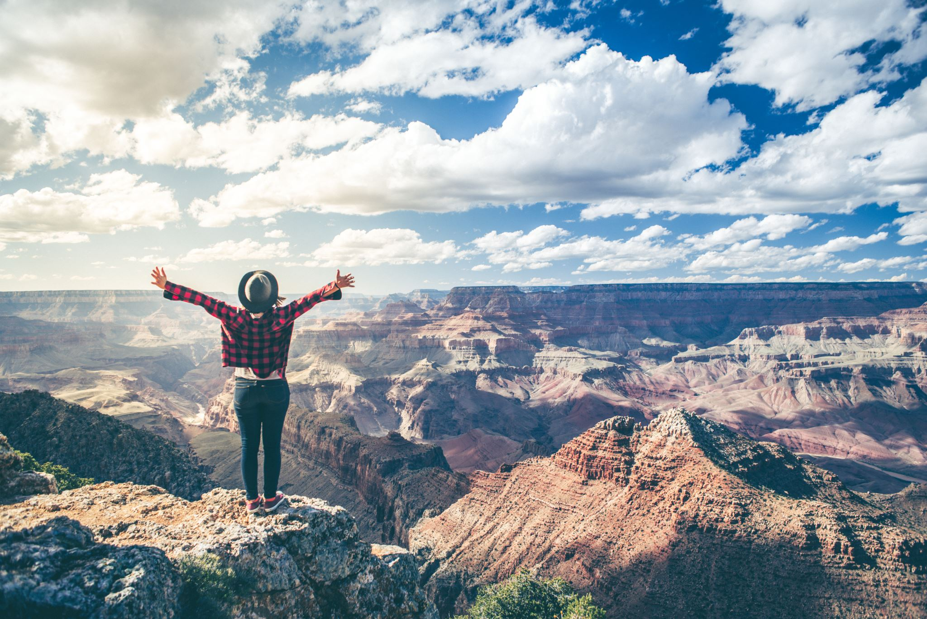
Faith is trust which shows itself in acting upon that trust.

Slide 9
God says to us, “Do you really, really believe? Then get in!”
We profess our belief in each time we pray the Creed, but when it comes to acting upon that belief we hesitate.
Jesus calls upon us to act upon our faith in basic ways.
Like little children, we are called to act upon our faith in trusting God.
To be able to act upon our trust, we must be convinced of God’s love for us.
Jesus reveals to us through his life, teaching and ministry the fullness of the Father’s Love for us
The Father lovingly waits for our response to his invitation for forgiveness, healing and love.
Through Jesus life, death and resurrection we have the ultimate proof of God’s love for us.

Slide 10
Your Grace is Enough
Great is Your faithfulness, o God
You wrestle with the sinner's heart
You lead us by still waters and to mercy
And nothing can keep us apart
So remember Your people
Remember Your children
Remember Your promise, o God
Your grace is enough
Your grace is enough
Your grace is enough for me

Slide 11
Great is Your love and justice, God of Jacob
You use the weak to lead the strong
You lead us in the song of Your salvation
And all Your people sing along
So remember Your people
Remember Your children
Remember Your promise, o God
Your grace is enough
Your grace is enough
Your grace is enough for me

Slide 12

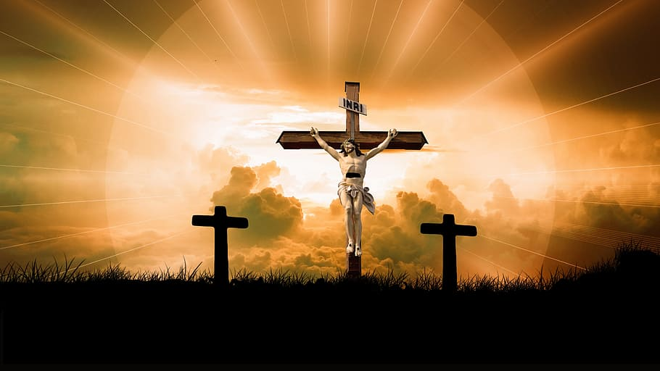
The Bridge

Slide 13
Discussion Questions
Discussion Questions Session 2
1. In what ways have you experienced the love of God in your life?
2. What kind of a mental picture do you have of Jesus?
3. Which of the Scriptural titles for Jesus are meaningful for you-
Good Shepherd, Lord, King of Kings, Christ, Lamb of God, Son of Mary, Savior, Bread of
Life, Healer, Brother, Word of God
4. What do your baptismal promises mean to you?
5. Does the truth of Christ’s personal love for me, proven from the height of the cross, fill me with awe and find an ever more generous response in my spiritual life?
Scripture
Jn. 3:16, Col. 1:13-14, Ezek. 36:22-28, Jn. 14:15-18, Acts 2:1-4, Gal. 5:22-23

Slide 14
Personal act of faith in the Father’s Love
Father, thank you for loving me.
Help me to believe in the depth of your love,
which led you to sacrifice your Son that I may live as your child.
May I trust completely in your love and become like a little child,
yielding myself to you totally.
I especially yield to you in the area where I feel you calling me to let go
of my own efforts and allow your love to work.
This is a symbol of how I desire to yield my entire life to you.
I pray this in the Name of Jesus. Amen

Slide 15
Ephesians 3:14-21
This, then, is what I pray kneeling before the Father… Out of his infinite glory, may he give you his power through his Spirit for your hidden self to grow strong so that Christ may live in your hearts through faith, and then, planted on love, you will, with all the saints, have strength to grasp the breadth, length, height and depth, until knowing the love of Christ, which is beyond all knowledge, you are filled with the very fullness of God. Glory be to him, whose power working in us , can do infinitely more than we can ask or imagine. Glory to him from generation to generation in the Church and in Christ Jesus for ever and ever. Amen

Slide 16
You Are Mine
I will come to you in the silence
I will lift you from all your fear
You will hear My voice
I claim you as My choice
Be still, and know I am near
I am hope for all who are hopeless
I am eyes for all who long to see
In the shadows of the night,
I will be your light
Come and rest in Me
Refrain
Do not be afraid, I am with you
I have called you each by name
Come and follow Me
I will bring you home
I love you and you are mine

Slide 17
I am strength for all the despairing
Healing for the ones who dwell in shame
All the blind will see, the lame will all run free
And all will know My name
Refrain
Do not be afraid, I am with you
I have called you each by name
Come and follow Me
I will bring you home
I love you and you are mine
I am the Word that leads all to freedom
I am the peace the world cannot give
I will call your name, embracing all your pain
Stand up, now, walk, and live
Refrain
Do not be afraid, I am with you
I have called you each by name
Come and follow Me
I will bring you home
I love you and you are mine

